Slide 1
Presentation on Titration
Name
Institution
Date

Slide 2
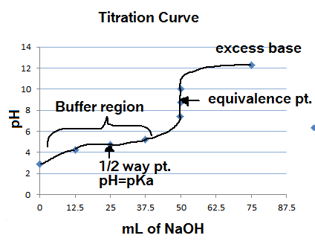
Introduction
In the field of chemistry, practical activities are essential and among the most common practical activities is titration.
According to Amador et al., (2020), Titration is a method of determining the concentration of dissolved substances in the smallest amounts of reagent a known concentration to brings about an effect with a known test solution.
There are different types of titration including the acid-base titration and back titration.
The purpose of titration is to determine the equivalent points at which the volume of the reactants mix uniformly (Avdeef et al., 2020).
Titrations are widely applicable and the acid-base titration is significant in in determining the pH level through the acid-base indicator.
Notes:
In the field of chemistry, practical activities are essential and among the most common practical activities is titration. According to Amador et al., (2020), Titration is a method of determining the concentration of dissolved substances in the smallest amounts of reagent a known concentration to brings about an effect with a known test solution. There are different types of titration including the acid-base titration and back titration. The purpose of titration is to determine the equivalent points at which the volume of the reactants mix uniformly. Titrations are widely applicable and the acid-base titration is significant in in determining the pH level through the acid-base indicator.

Slide 3
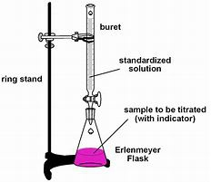
Instrumentation
Apparatus
  Burette, 50 cm³
  Pipette, 25 cm³
  Conical flask, 100 cm³
  Beaker 100 cm³
  Stand and clamp
  Funnel
  White tile
  Dropper
Reagents
  Known concentration of NaOH
  The unknown concentration of 100 ml HCl
  Phenolphthalein indicator
Notes:
A practical activity cannot be done without apparatus and reagents. The main glassware to be used in the reaction include; Burette, 50 cm³, Pipette, 25 cm³, Conical flask, 100 cm³, Beaker 100 cm³, Stand and clamp, Funnel, White tile, and Dropper. The reagents to be used in the titration activity include; known concentration of NaOH, the unknown concentration of 100 ml HCl, and phenolphthalein indicator.

Slide 4
Procedures
Mount the 50cm³ on a stand and clamp, and poor HCL using a funnel up to the zero mark.
Pipette 25 cm³ of NaOH and place it in a conical flask.
Place the conical flask with 25 cm³ of NaOH on a white tile beneath the clump and stand.
Add exactly three drops of phenolphthalein indicator to the NaOH in the conical flask.
Titrate the NaOH using HCl as you whirl until the solution turns from purple to colorless and record the volume.
Repeat the procedure thrice and use the collected values to calculate the average volume and the concentration of HCl.
Notes:
Mount the 50cm³ on a stand and clamp, and poor HCL using a funnel up to the zero mark. Pipette 25 cm³ of NaOH and place it in a conical flask. Place the conical flask with 25 cm³ of NaOH on a white tile beneath the clump and stand. Add exactly three drops of phenolphthalein indicator to the NaOH in the conical flask. Titrate the NaOH using HCl as you whirl until the solution turns from purple to colorless and record the volume. Repeat the procedure thrice and use the collected values to calculate the average volume and the concentration of HCl.

Slide 5
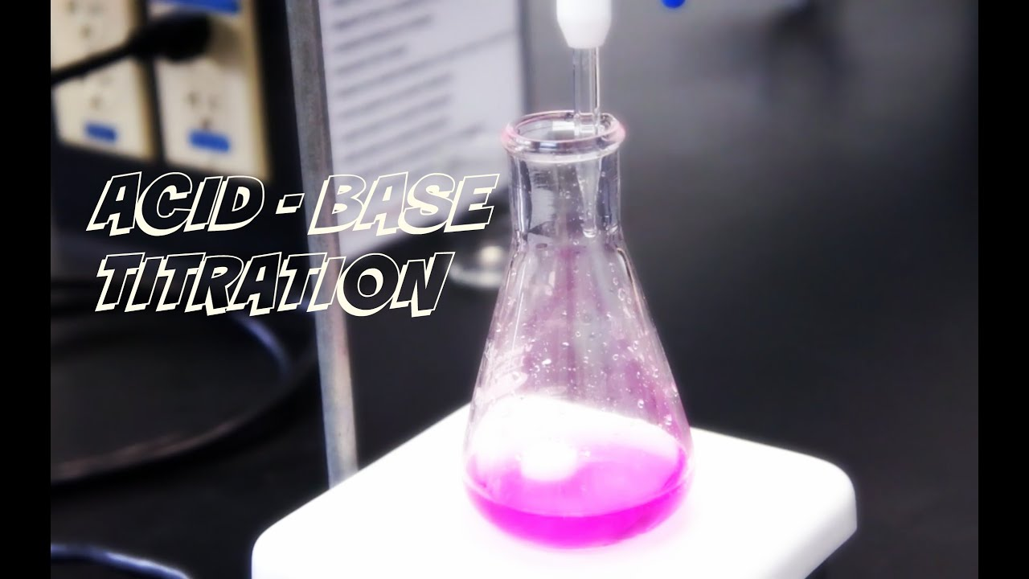
Observations and Expectations
In the course of the titration, the titrant (NaOH) is added to unknown solution and the HCl is slowly reacted away.
The equivalent point must be reached and this is the point at which exactly enough titrant (NaOH) has been added to react with all of the analyte (HCl).
The indicator used in the reaction is phenolphthalein and this is based on the fact that the indicator is favorable for strong acid titrated with strong bases (Hoang, 2017).
Phenolphthalein indicator appears pink in basic solutions and clear in acidic solutions.
At the equivalent point, the pink color fades away and this is my expectation in the titration.
Notes:
In the course of the titration, the titrant (NaOH) is added to unknown solution and the HCl is slowly reacted away. The equivalent point must be reached and this is the point at which exactly enough titrant (NaOH) has been added to react with all of the analyte (HCl). The indicator used in the reaction is phenolphthalein and this is based on the fact that the indicator is favorable for strong acid titrated with strong bases (Hoang, 2017). Phenolphthalein indicator appears pink in basic solutions and clear in acidic solutions. At the equivalent point, the pink color fades away and this is my expectation in the titration.

Slide 6
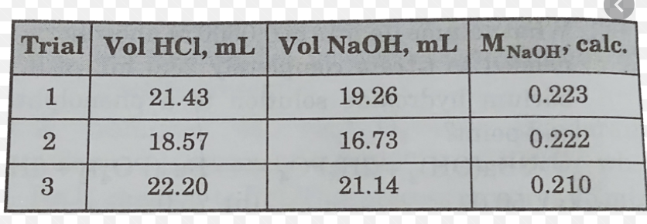
Results to be Used in Computation
Notes:
From the values given above, the calculations of will be done to determine the molarity of hydrochloric acid

Slide 7
Calculations
The equation for the reactants used in the reaction is;
HCl(aq)+NaOH(aq)→H2O(l)+NaCl(aq)HCl(aq)+NaOH(aq)→H2O(l)+NaCl(aq)
The mole ratio of reactants is 1:1.
Using data from the third trail, the titre volume of HCl is 22.20 ml while that of NaOH is 21.14ml with a molarity of 0.210.
The moles of NaOH will then be; Molarity (M) x Volume (L). The volume will be converted in to liters by dividing by 1000 and so the volume to be computed is 0.02114L.
Therefore, moles = 0.210 x 0.02114 = 0.0044394 moles. As per the mole ratio of 1:1, the moles of HCl are as well 0.0044394
The molarity of HCL will be calculated by multiplying moles and volume in liters. That is; 0.0044394 moles x 0.0222L= 0.00001 M.
Notes:
The equation for the reactants used in the reaction is; HCl(aq)+NaOH(aq)→H2O(l)+NaCl(aq)HCl(aq)+NaOH(aq)→H2O(l)+NaCl(aq).The mole ratio of reactants is 1:1. Using data from the third trail, the titre volume of HCl is 22.20 ml while that of NaOH is 21.14ml with a molarity of 0.210. The moles of NaOH will then be; Molarity (M) x Volume (L). The volume will be converted in to liters by dividing by 1000 and so the volume to be computed is 0.02114L. Therefore, moles = 0.210 x 0.02114 = 0.0044394 moles. As per the mole ratio of 1:1, the moles of HCl are as well 0.0044394. The molarity of HCL will be calculated by multiplying moles and volume in liters. That is; 0.0044394 moles x 0.0222L= 0.00001 M.

Slide 8
References
Amador, C., Liu, F. W., Johnson-Glenberg, M. C., & LiKamWa, R. (2020, June). Work-in-Progress—Titration Experiment: Virtual Reality Chemistry Lab with Haptic Burette. In 2020 6th International Conference of the Immersive Learning Research Network (iLRN) (pp. 363-365). IEEE.
Avdeef, A., Berger, C. M., & Brownell, C. (2020). pH-metric solubility. 2: correlation between the acid-base titration and the saturation shake-flask solubility-pH methods. Pharmaceutical research, 17(1), 85-89.
Hoang, V. D. (Ed.). (2017). Advances in Titration Techniques. BoD–Books on Demand.

